Slide 1

COMMODITIES – A MARKET ANALYSIS BY GROUP D
Presented by:
Hari Kolli
Ksenjiya Cadajeva &
Aaron Simpson

Slide 2
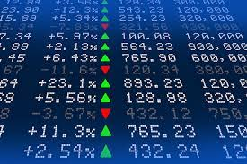
CONTENTS &
OVERVIEW OF PRESENTATION:
Use yahoo indices package to display data allowing comparison of indices.
Calculate the moving averages of the commodities and compare performance.
Overlay Prices of all commodities to see if there is one that outperformed and or underperformed the others.
Analyze and prepare previous commodities data to current commodities data. We thought this a necessary question given current economic situations.
How to accurately plot and display the data. Have commodities maintained their value ?
Calculate daily, monthly or yearly (or all) returns of commodities.
Combine all data frames to then correlate and plot relations between the commodities.
Plot closing prices of said commodities and plot accordingly.

Slide 3

COLLECTION AND PREPARATION OF DATA:
Various commodities prices were downloaded in CVS format and then uploaded and pathed into JupyterLab. From there the team began reading in the data accordingly.
Once the data had been read in, all CSV’s were turned into their appropriate data frames with the necessary dates being parsed and extraneous columns being dropped.
Once each data frame had been read in they were combined into a combined data frame which displayed our chosen list of commodities and their closing prices.
From there the data frame was converted to display the values in AUD and concatenated as such.
Columns were renamed to reflect the commodities closing prices, from there daily returns cumulative returns were calculated.
Annual standard deviation was then calculated for the commodities as well.

Slide 4
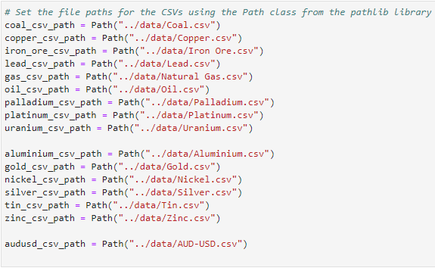
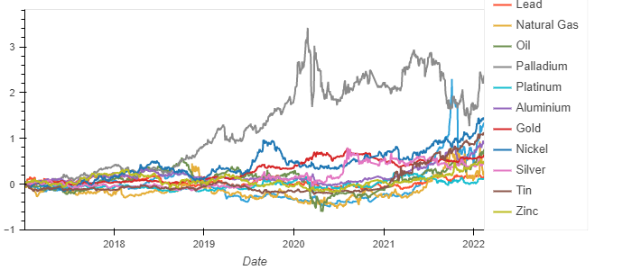
EXAMPLES OF CODE USED AND PLOTS DISPLAYED:

Slide 5
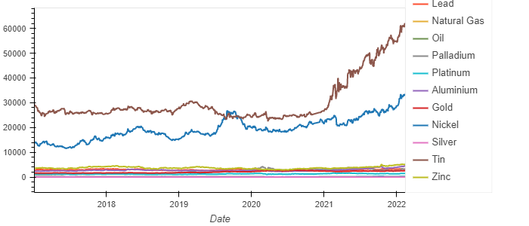
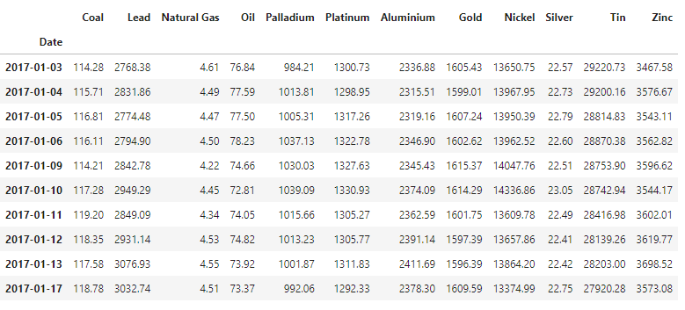
DATA CLEANUP AND HOW IT WAS PRESENTED:
Various commodities data was downloaded and then read into JupyterLab as CSV Files. Once the data was read in, it was then combined, sorted and plotted accordingly.
Once combined the data was then presented within the notebook with some necessary adjustments made such as the renaming of the columns to reflect the correct prices of said commodity.
The commodities data frame was then displayed by using the hvplot() function. Once read in the daily returns were then calculated and displayed also using the hvplot() function.
After this the commodities were then split into their categories which were “Energy, Industrial Metals and Precious Metals”.

Slide 6
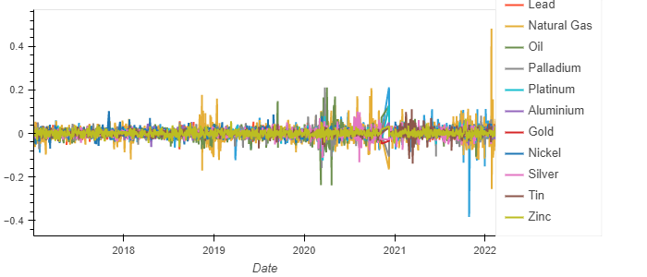
DATA CLEANUP AND HOW IT WAS PRESENTED:
Once the daily returns were calculated these results were also displayed in a hvplot which confirmed that natural gas had the highest percentage change.
From there the cumulative daily returns were calculated and plotted accordingly. From this data we can see that the daily returns from Palladium were the highest increase as well as the highest closing price. The highest closing price for Palladium was 3.415 on the 27/02/2020.
We can also see that one of the worlds most solid commodities (gold) was stable throughout the years with noticeable increases in 2020 and staying stable from there on out.

Slide 7
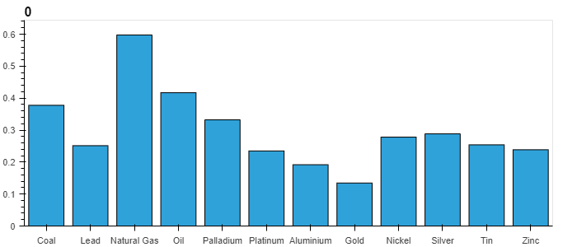
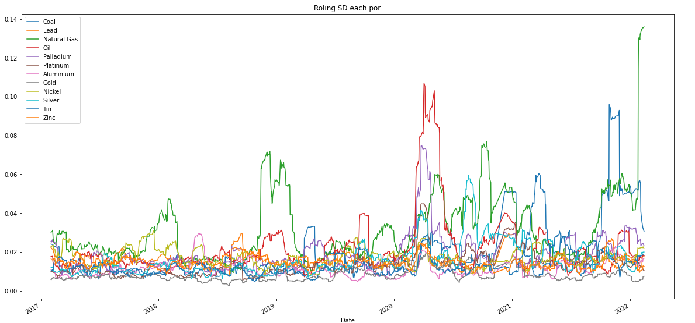
DATA CLEANUP AND HOW IT WAS PRESENTED:
Once the commodities were categorized the daily returns were then calculated and extraneous columns were deleted.
After the commodities were categorized, it became clear that we would also need to calculate the annual standard deviation of the commodities with Natural Gas returning highest on the scale and gold the lowest.
This indicates that Natural Gas is the most volatile whilst gold had remained the most stable commodity.
From here the standard deviation was also calculated and plotted with a 21 day rolling average.

Slide 8
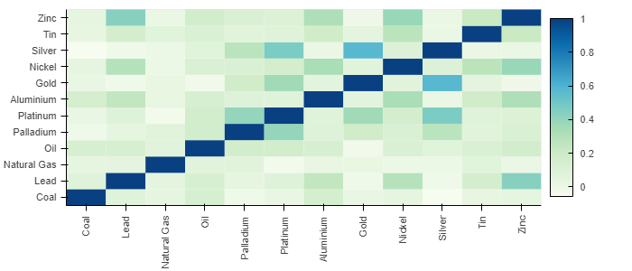
DATA CLEANUP AND HOW IT WAS PRESENTED:
Once the standard deviation had been calculated for the chosen commodities, the daily cumulative returns for our chosen commodities sectors referenced before (Energy, Precious Metals & Industrial Metals) plots in next slide.
These plots indicated the following, palladium had the highest closing prices in not only the precious metals section but all over throughout all commodities. Nickel was the highest increasing in the Industrial Metals sections and throughout the energy sector that coal had the highest increase and closing price.
We can also see that one of the worlds most solid commodities (gold) was stable throughout the years with noticeable increases in 2020 and staying stable from there on out.
After this a correlation matrix was plotted to display a heatmap indicating the relation between commodities (attached below):

Slide 9
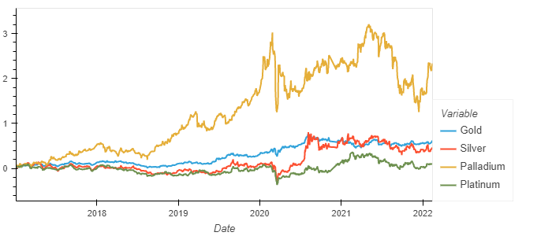
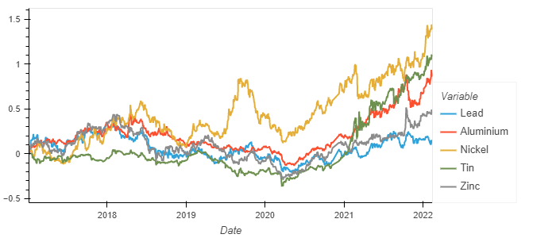

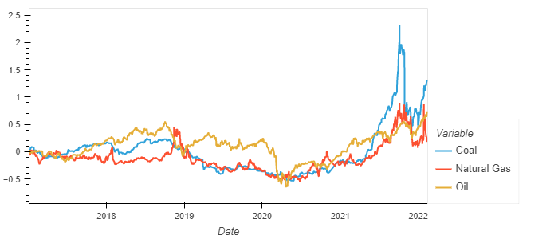
DATA CLEANUP AND HOW IT WAS PRESENTED:

Slide 10
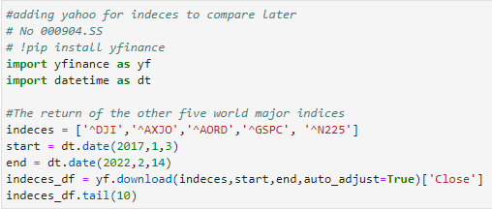
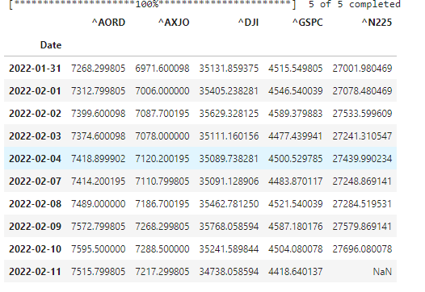
USE OF SECOND PYTHON LIBRARY:
Added yahoo finance library to return the major world indices to reflect the closing prices to correlate and compare with closing prices for commodities.
Once this data was imported it was then turned into a data frame and plotted. The goal of this data was to indicate economic health, as commodities such as gold and silver have always been indicators of economic health.
The indices daily returns were then calculated and plotted accordingly.

Slide 11

DATA CLEANUP AND HOW IT WAS PRESENTED:
Once the data had been sourced from Yahoo Finance, the daily returns were then calculated with all un-necessary columns dropped.
From here we were able to plot the daily returns of all the major indices which allowed to extrapolate the best performing indices.
After the indices data had been cleaned and presented, we wanted to calculate some economic indicator results.
We used the gold to palladium ration to determine economic health, The indicator works just as the gold-to-silver ratio or gold-to-platinum ratio and it shows how many ounces of palladium one ounce of gold can buy. It measures the relative value of gold and palladium, indicating whether gold or palladium are undervalued or overvalued relative to each other.

Slide 12
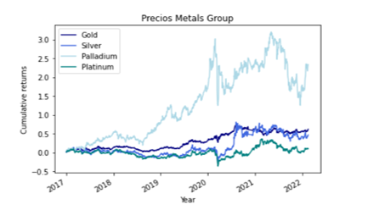
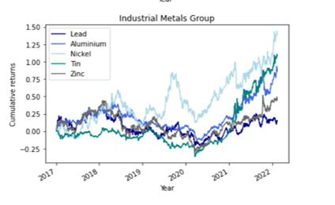
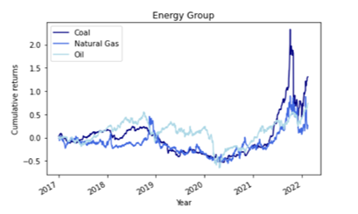
DASHBOARD REPRESENTING CUMULATIVE RETURNS IN THE THREE COMMODITIES GROUPS:

Slide 13
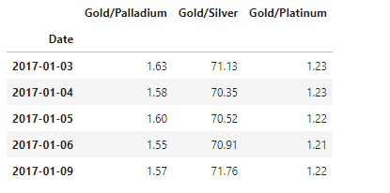
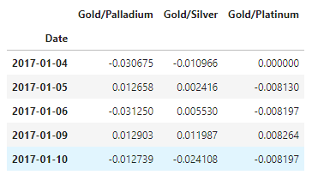
DATA CLEANUP AND HOW IT WAS PRESENTED:
After entering the ratios into our notebook, they were displayed, another reason for displaying the rations is that certain commodities, such as gold, will increase in price during economic downturns. Gold is considered a safe-haven asset, so investors consider it a store of value during periods of economic uncertainty. If the price of gold rises, it can be a sign that the economy is slowing, and investors are seeking out more stability. If the price of gold declines, it is a sign that investors are moving their money into higher-risk assets.
Our results indicated that gold is currently undervalued to palladium and is also undervalued compared to platinum as well.
From here the ratios and percentage changes were also calculated, with null results dropped from the results.

Slide 14
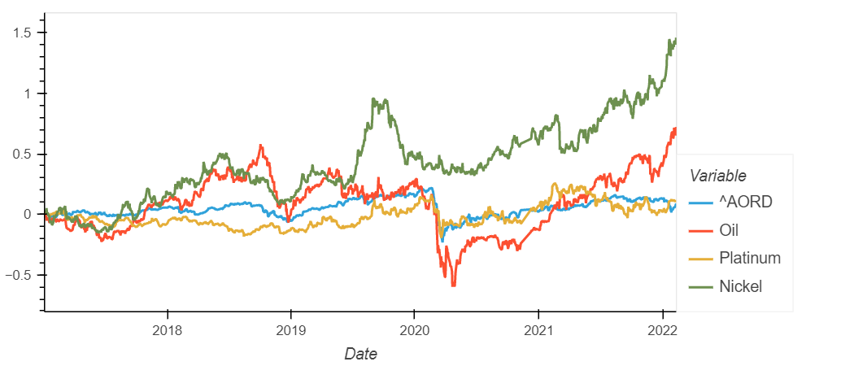
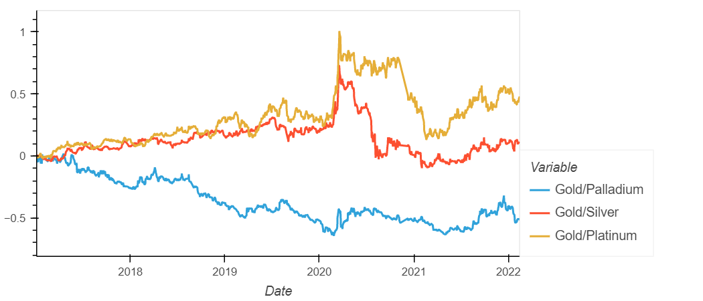
DATA CLEANUP AND HOW IT WAS PRESENTED:
From correlations analysis we selected the most related commodities to ASX All Ords , which were Oil, Platinum and Nickel and plotted them accordingly.
We explored that Gold/Palladium,Gold/Silver and Gold/Platium ratios can be great economic indicators
Palladium happens to be the most industrially used metal of the precious metals class. While the demand for palladium is overwhelmingly derived from industrial uses and sources at approximately 90% of its allocation, gold receives less than 10% of its demand from industrial applications.
Latest moves in ratios perfectly showed slowed down of economy in the latest months

Slide 15
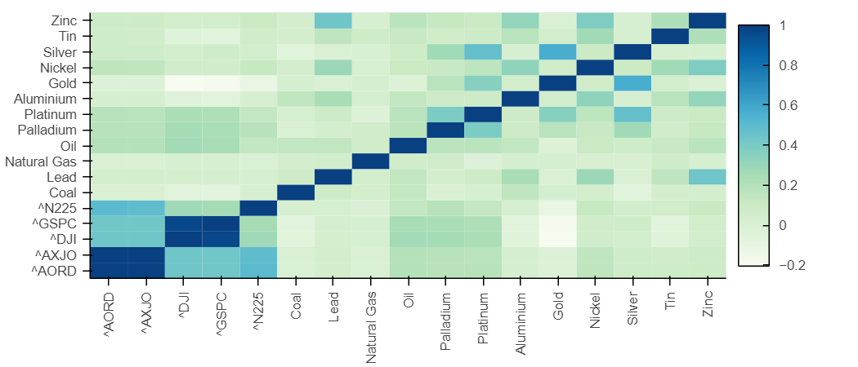
DATA CLEANUP AND HOW IT WAS PRESENTED:
From here the data frames of the indices and the commodities was combined. From here cumulative returns were calculated and correlated.
The results of these heatmaps are below:

Slide 16

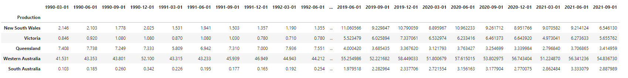
DATA CLEANUP AND HOW IT WAS PRESENTED:
Another angle taken was looking at the production and export of commodities nationally within Australia.
Various CSV Data sources were imported and red into our notebook.
From the data gathered from 1990 onwards we were able to determine that Western Australia is the country’s largest exporter of Gold.

Slide 17
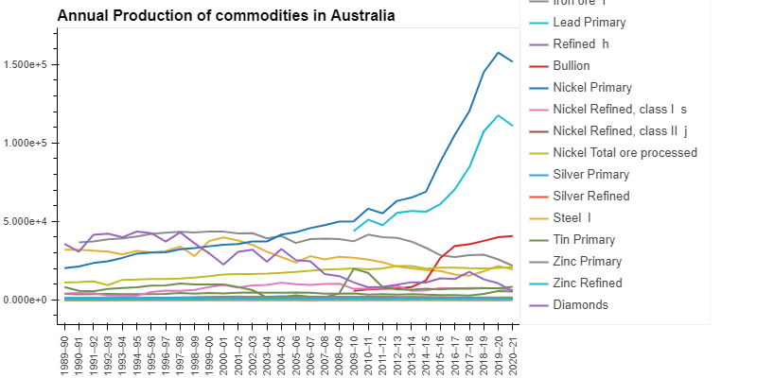
DATA CLEANUP AND HOW IT WAS PRESENTED:
After this we plotted the annual zinc production according to the states. With WA being the highest exporter of Zinc, and Australia producing over 25,000 kilo tones in 2019.
We were also able to plot the annual production of all commodities throughout Australia, which showed that gas was our highest export rising significantly from 2015 onwards.

Slide 18
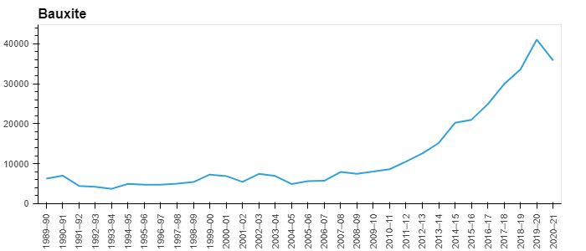
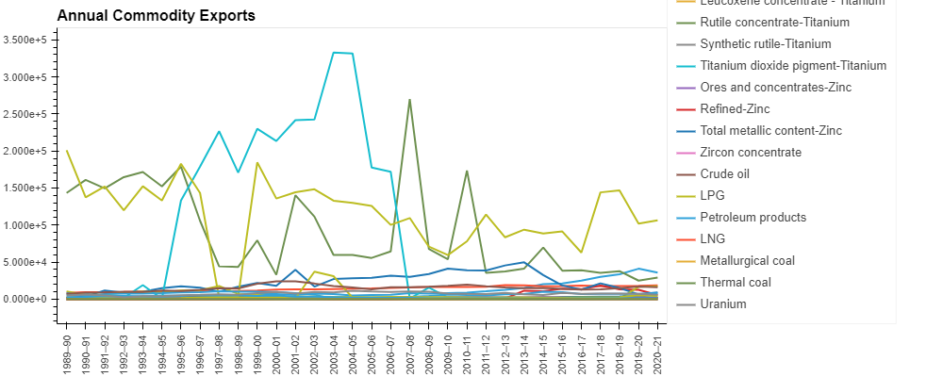
DATA CLEANUP AND HOW IT WAS PRESENTED:
An interactive chart for annual commodity was produced as well as for annual commodity exportation as well.
From these charts we can see that limestone had a significant increase in demand and exportation from 1995 to 2004 and then followed by a steep decline in demand.
We then also plotted an interactive chart for exports from each state.
A chart was also plotted for gold export per state, with Western Australia being our biggest exporter with over 54 k tones being exported in 2021, with Australia exporting a total of over 82 k tones in total for 2021.

Slide 19
END OF PRESENTATION AND QUESTIONS

